Slide 1
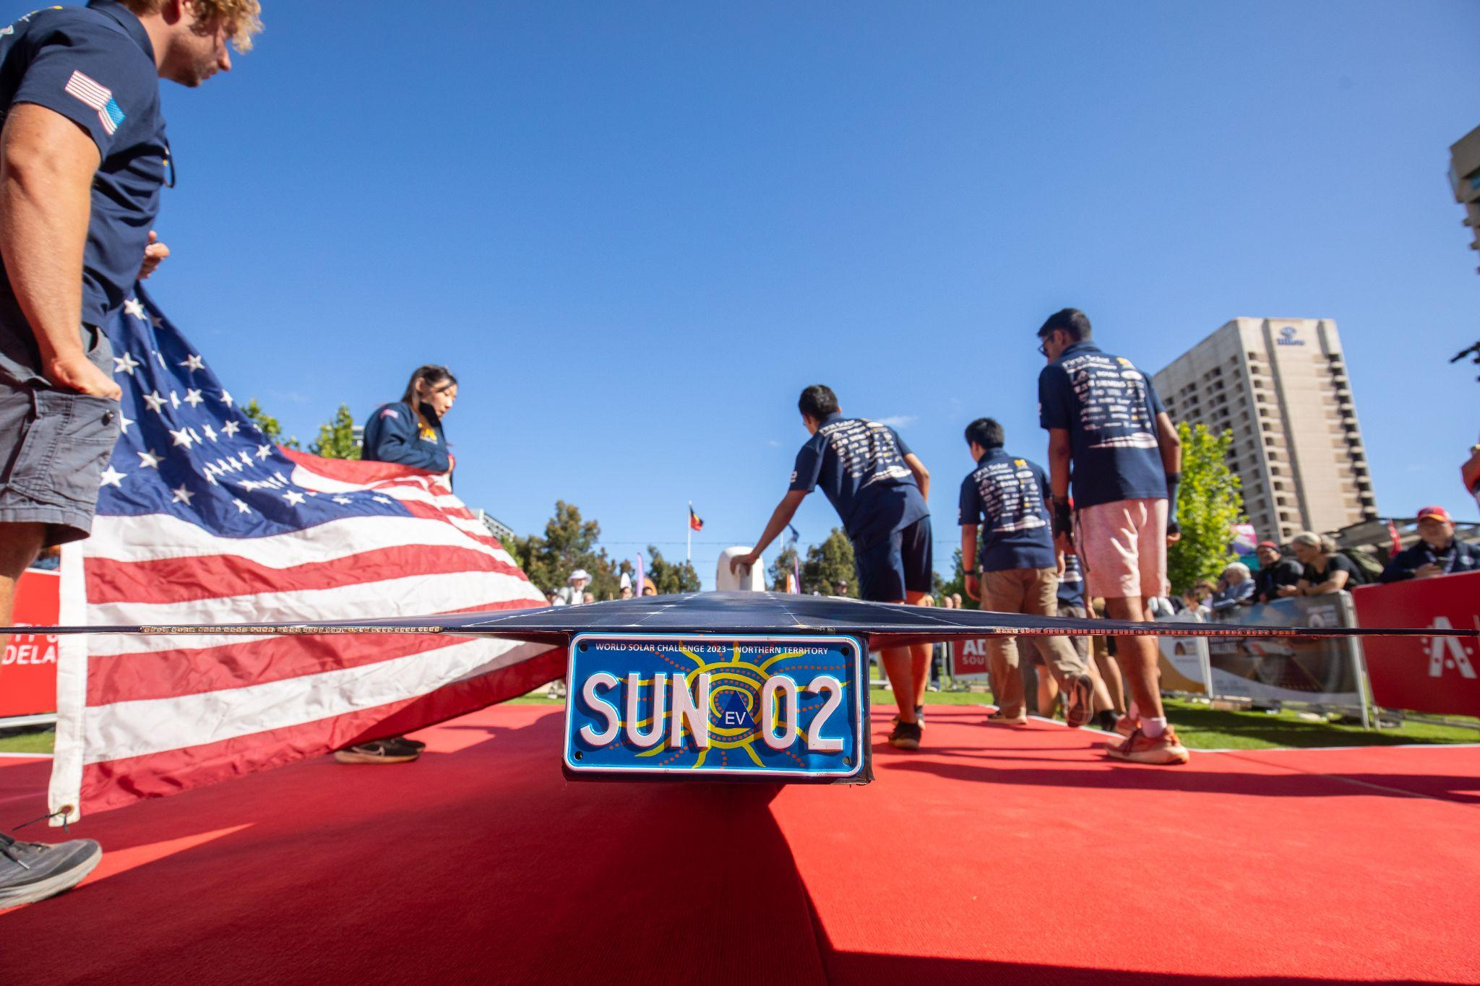

Slide 2
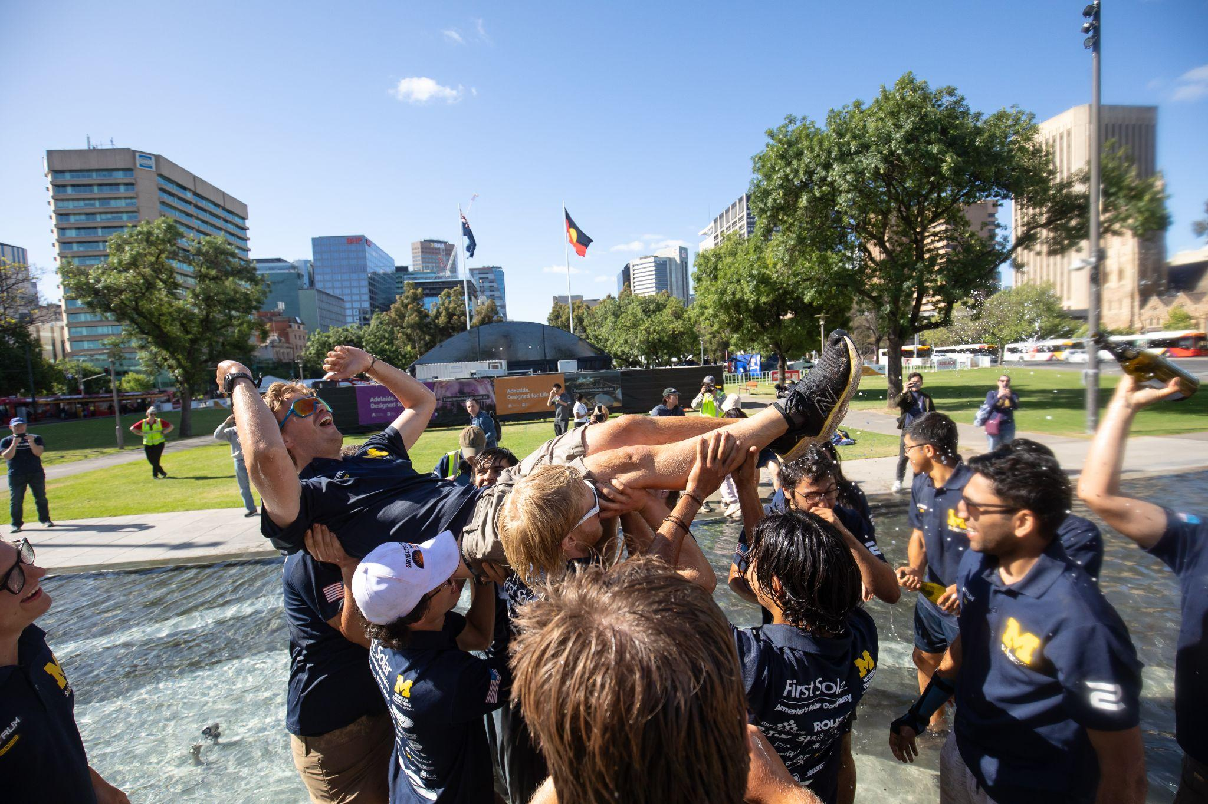
About me:
Team co-founder: Okemos Solar Racing Club
Student: University of Michigan
Team co-founder: The Cannonball Sun NY2LA
Team Leader: University of Michigan Solar Car Team (2022 - 2023)
Currently: Mechanical design engineer intern at SpaceX
Forever: Solar car obsessed

Slide 3
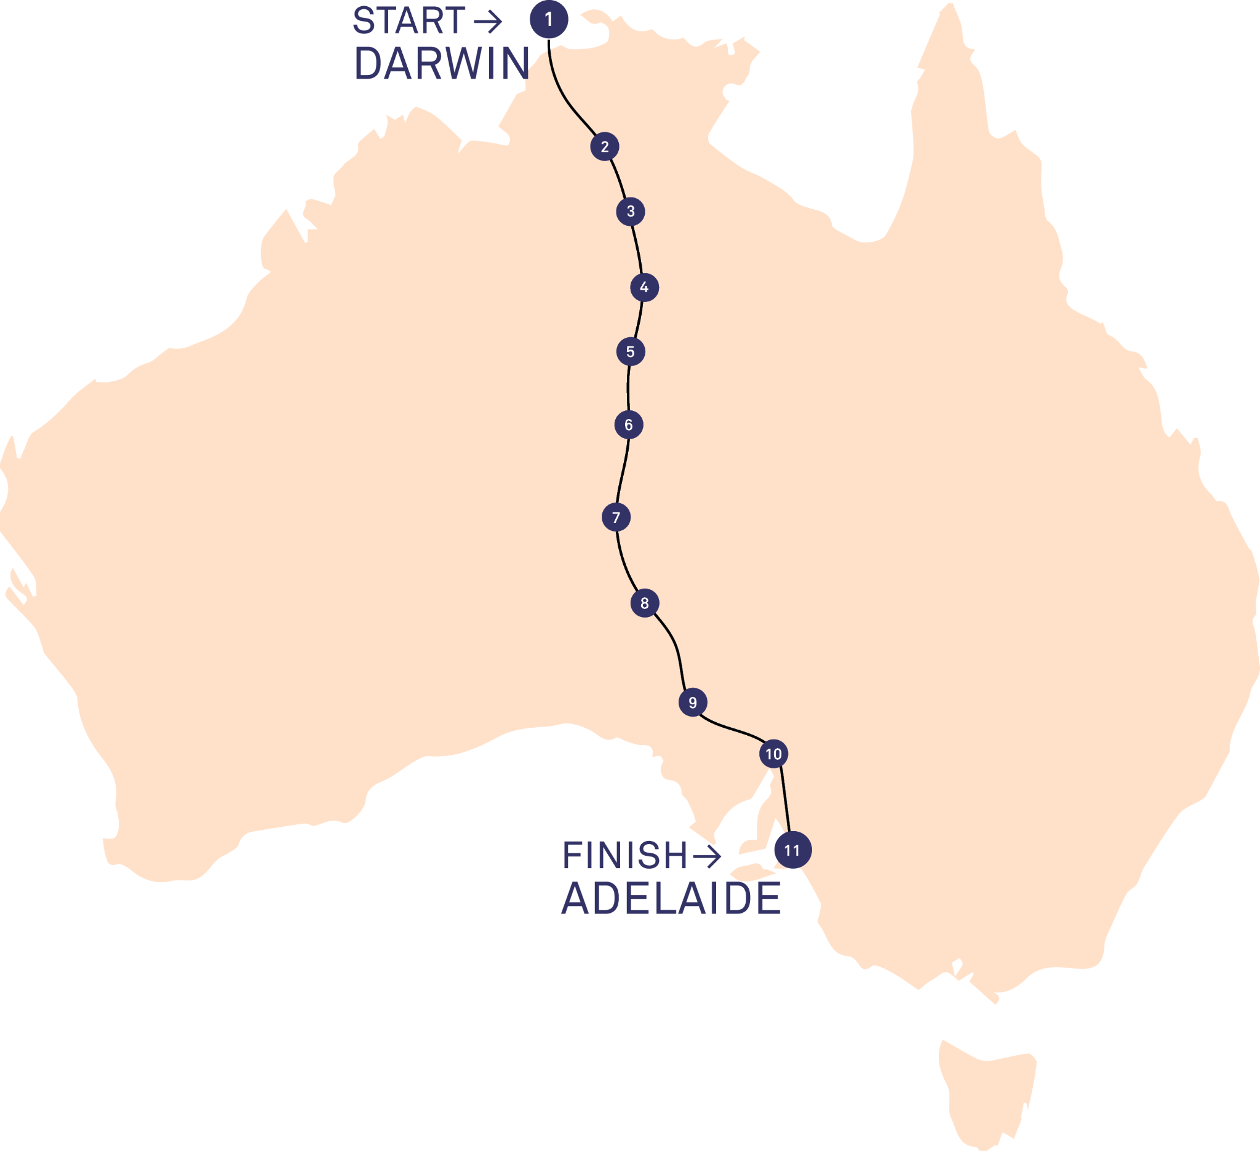

Slide 4
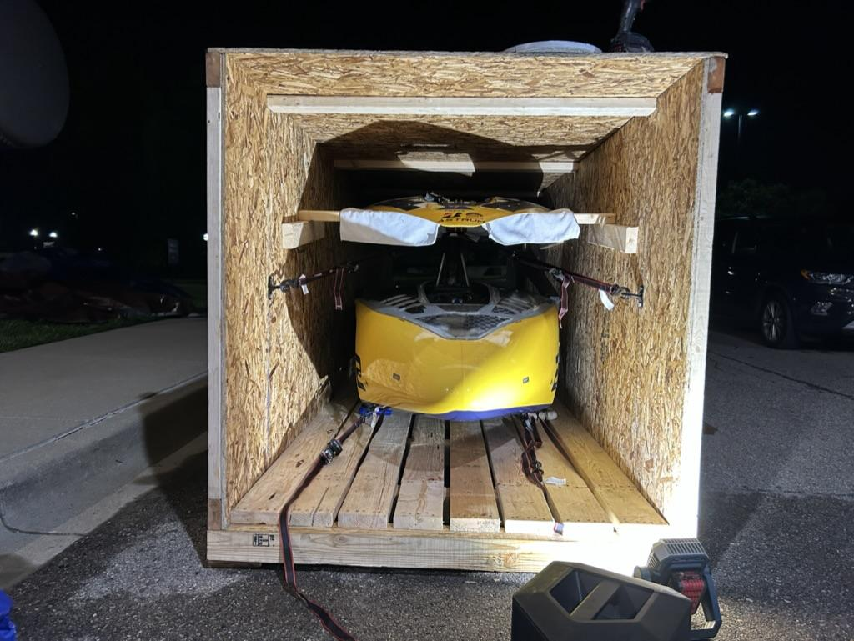
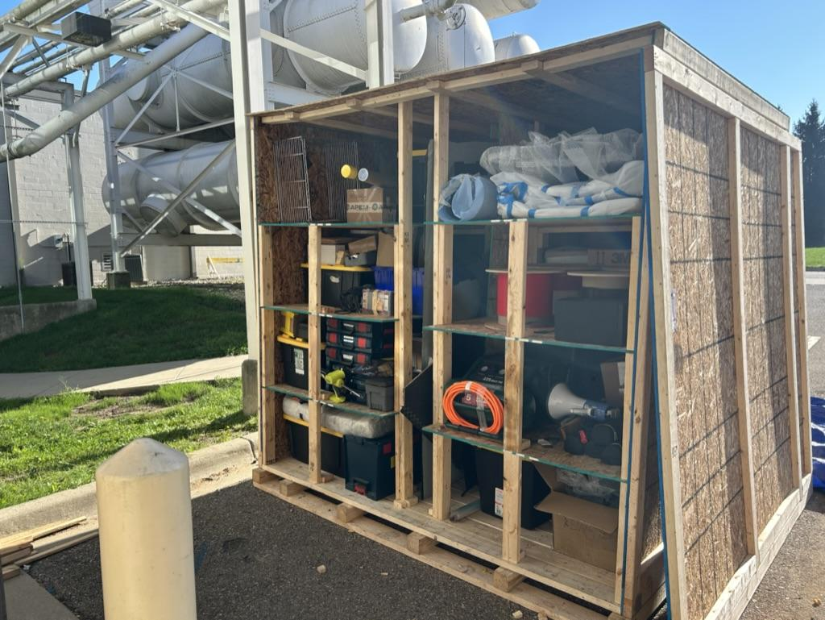
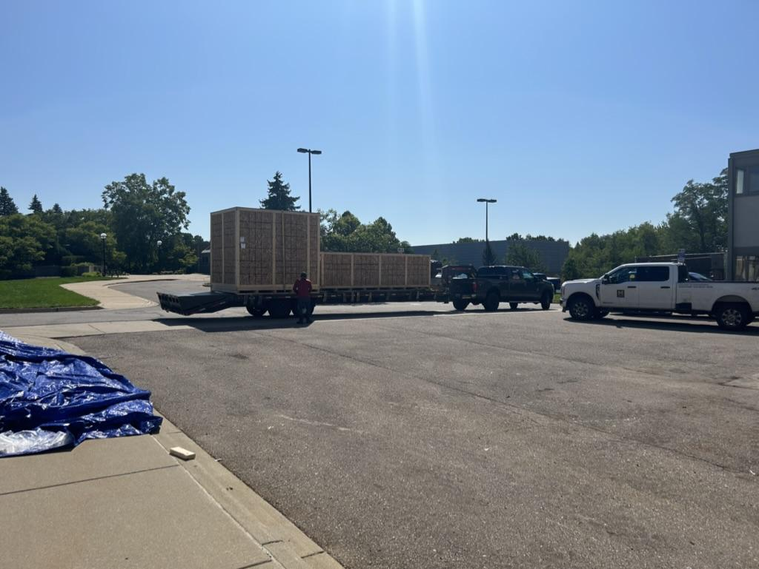

Slide 5
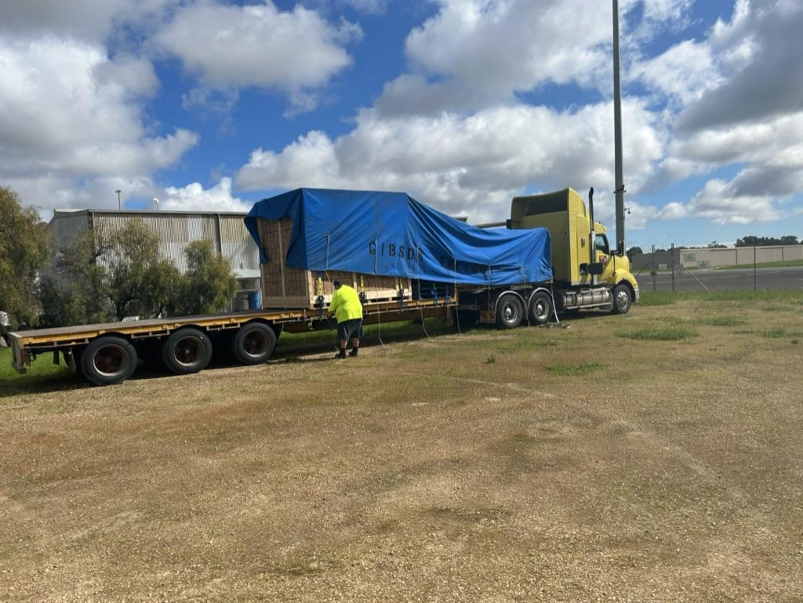

Slide 6
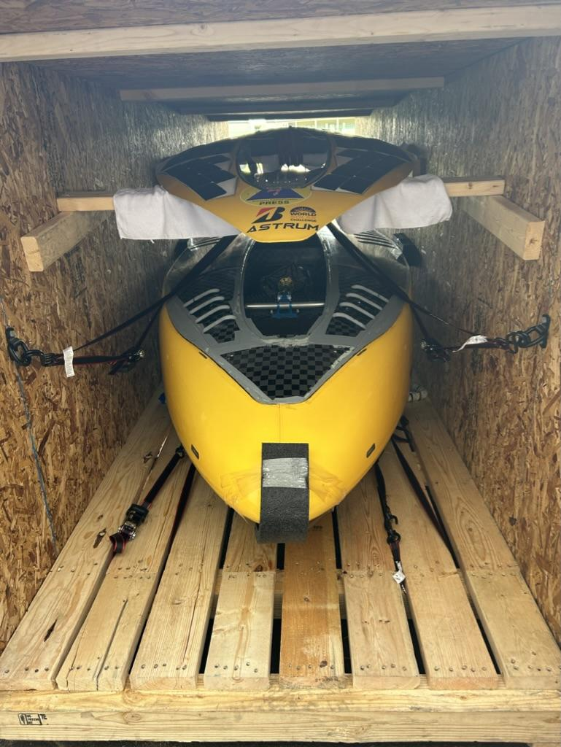
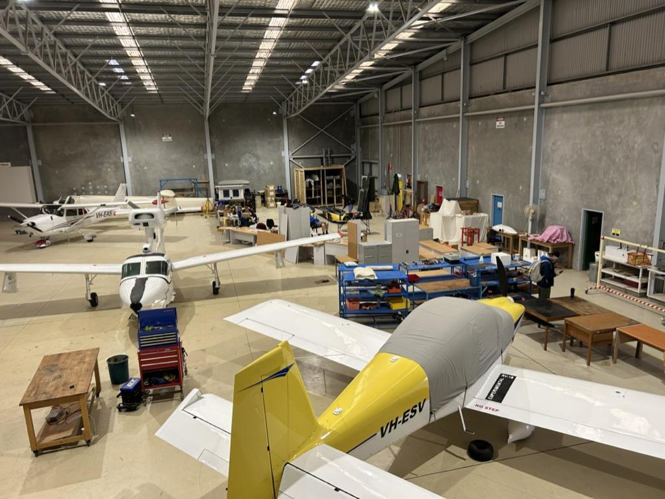

Slide 7
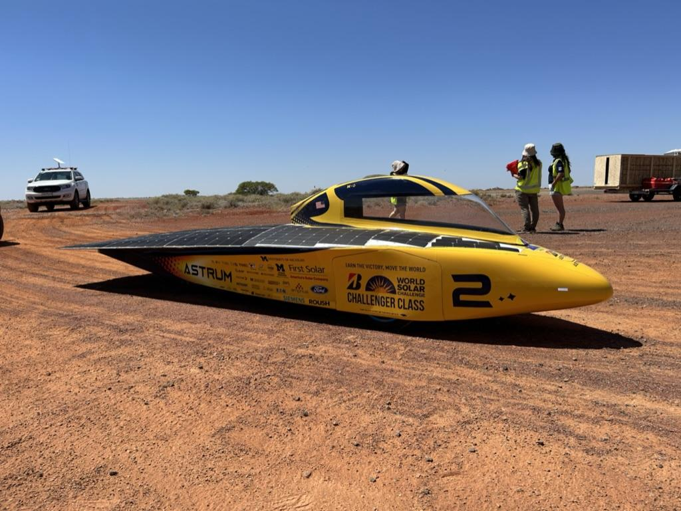
ASTRUM
CdA: .059 (CFD) .067 (Actual)
Weight: 162.3 (no driver)
Battery: 20kg Amprius Silicon Nanowire 8kwh
Tires: 3x Bridgestone Enliten
Solar array: 4m2 Maxeon Sunpower, “Mito” encapsulant, ~1000w at STC
Power at 80kmh: ~700 watts
Chassis & body: Prepreg carbon fiber, nomex, rohacell, & titanium roll cage

Slide 8
Design Philosophy
Race time

Slide 9
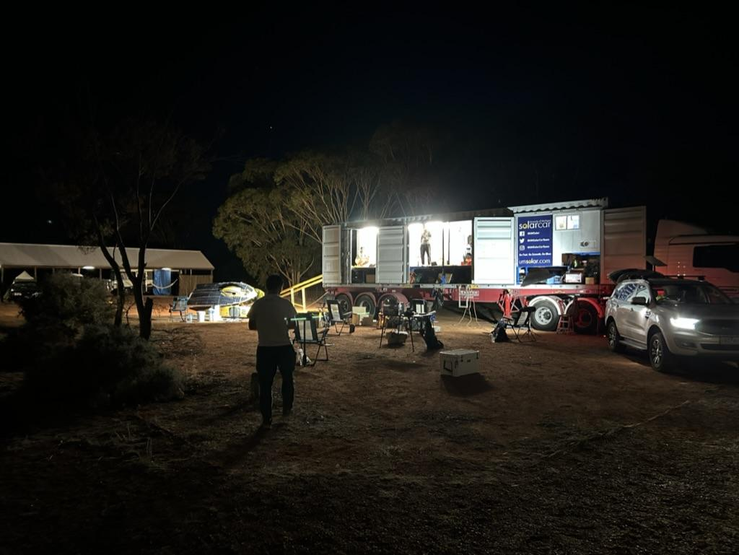
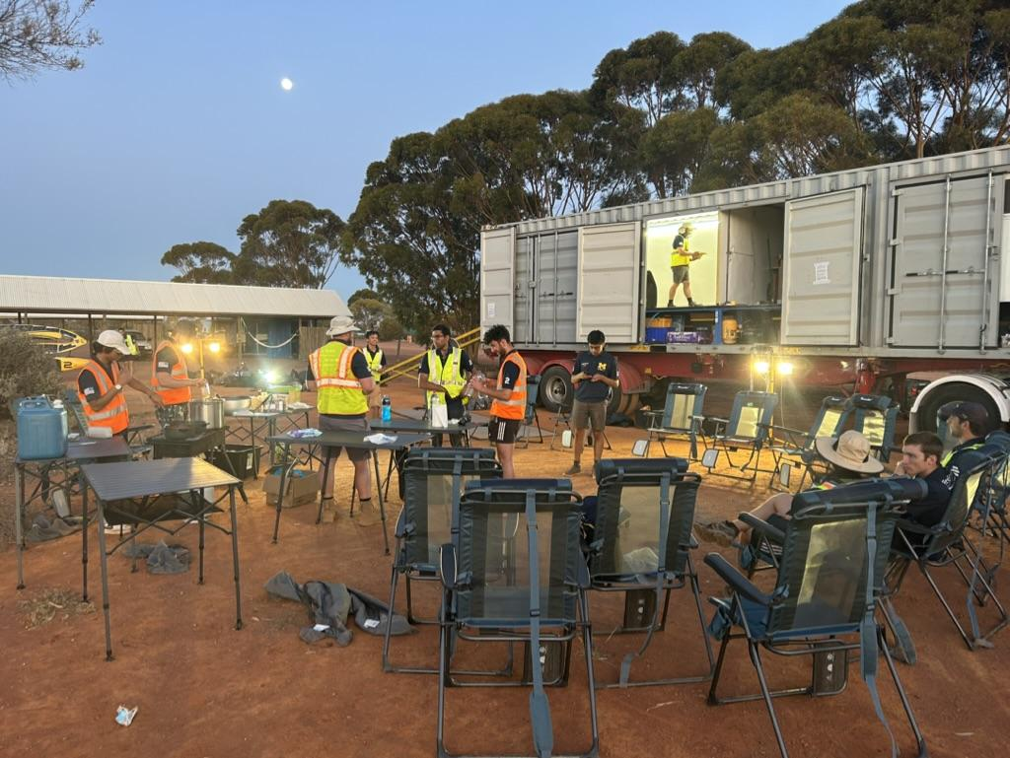

Slide 10
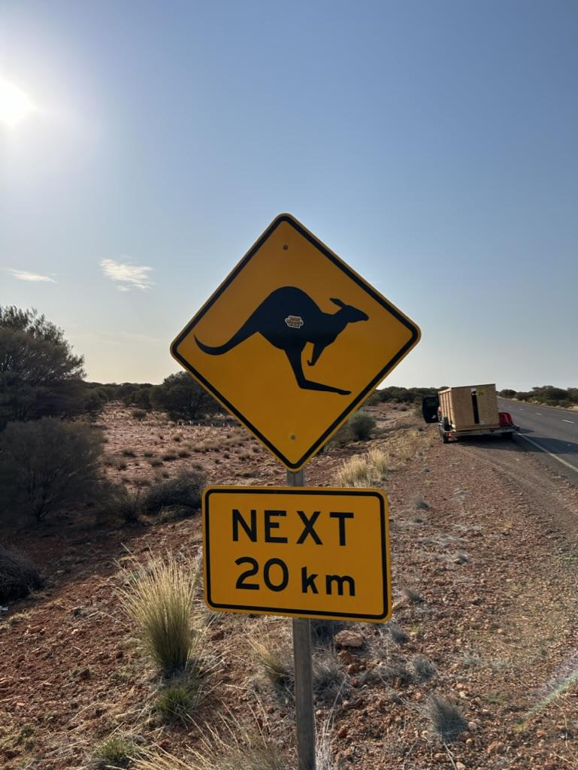
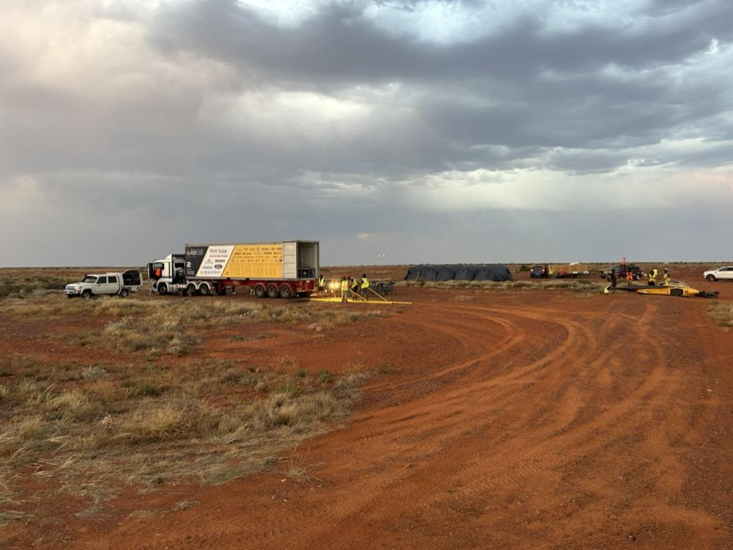

Slide 11
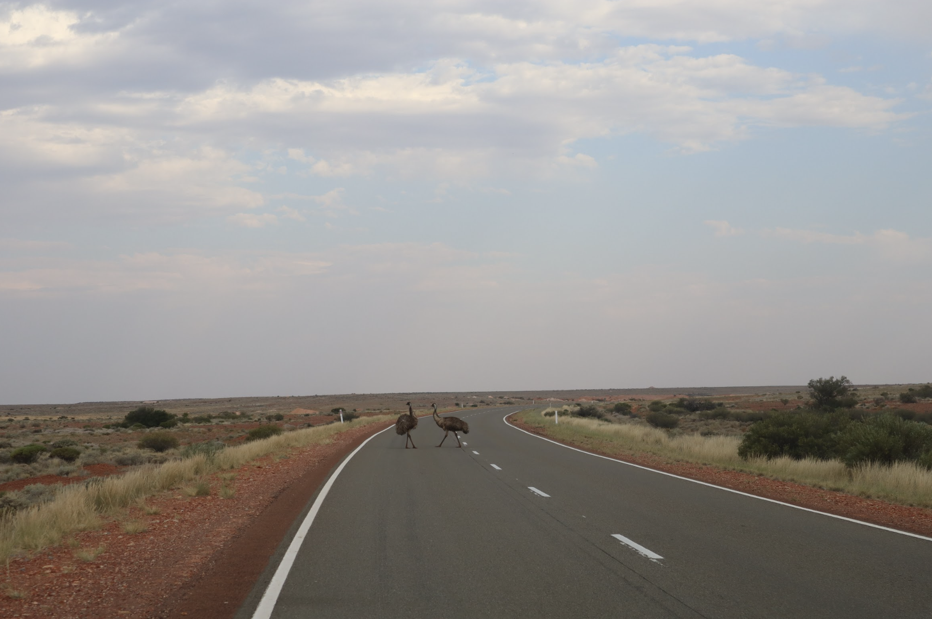

Slide 12
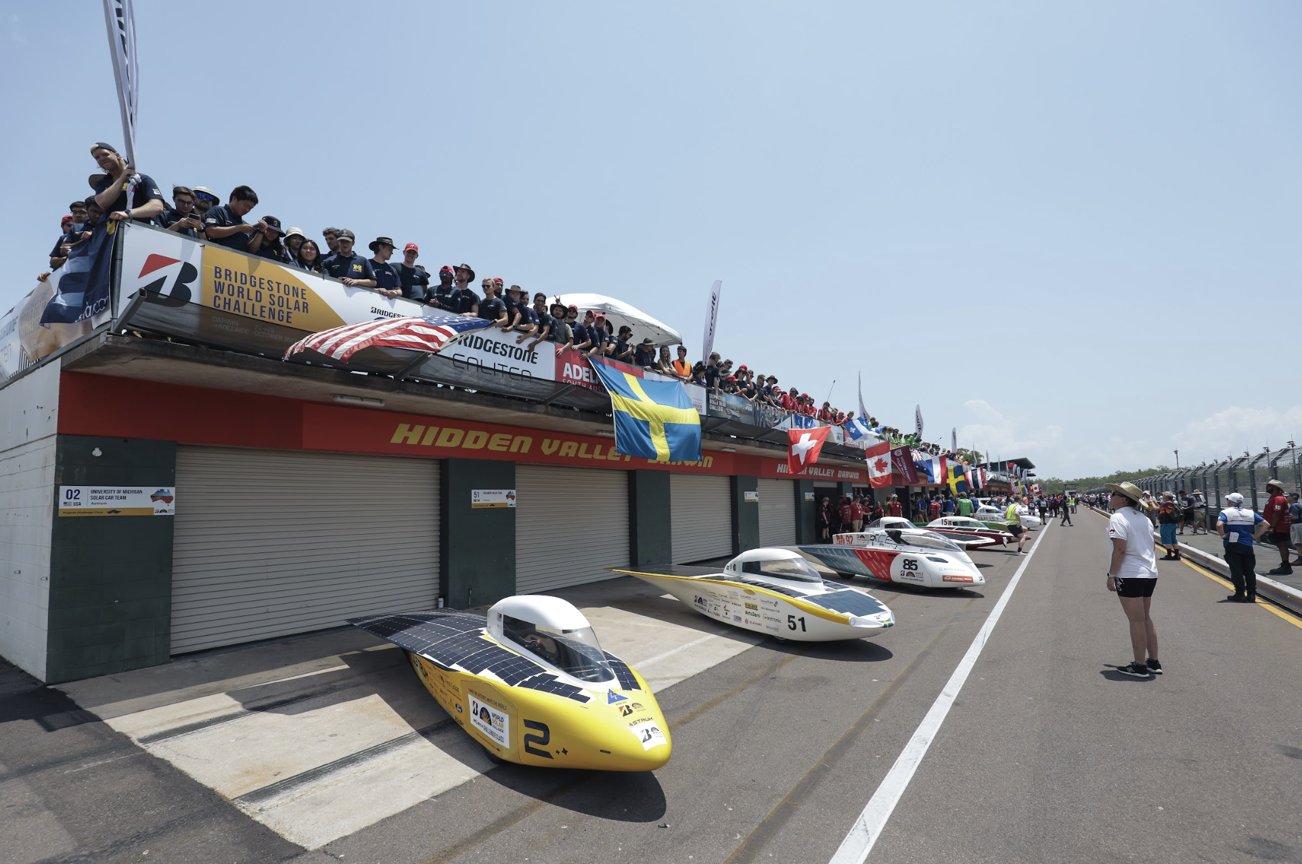

Slide 13
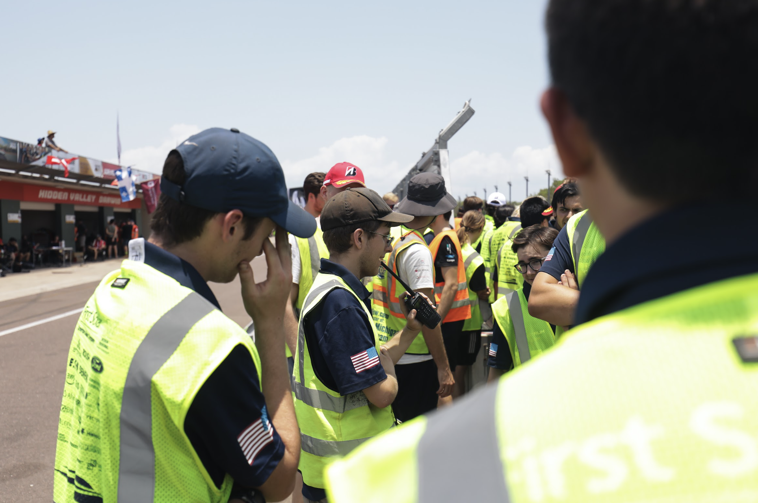

Slide 14
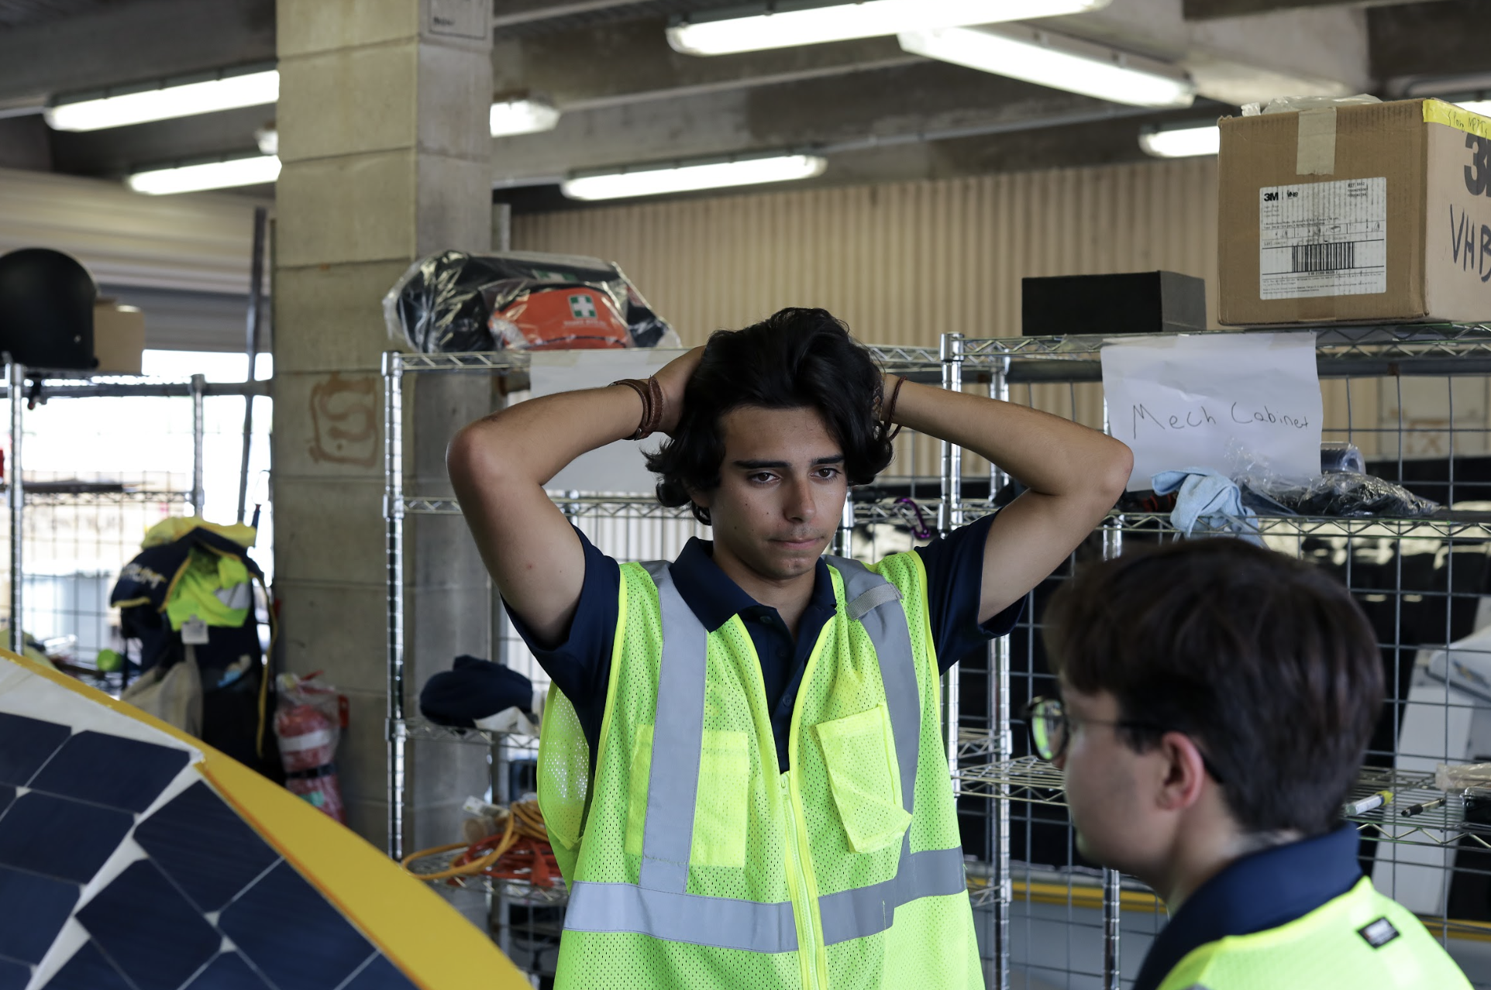

Slide 15
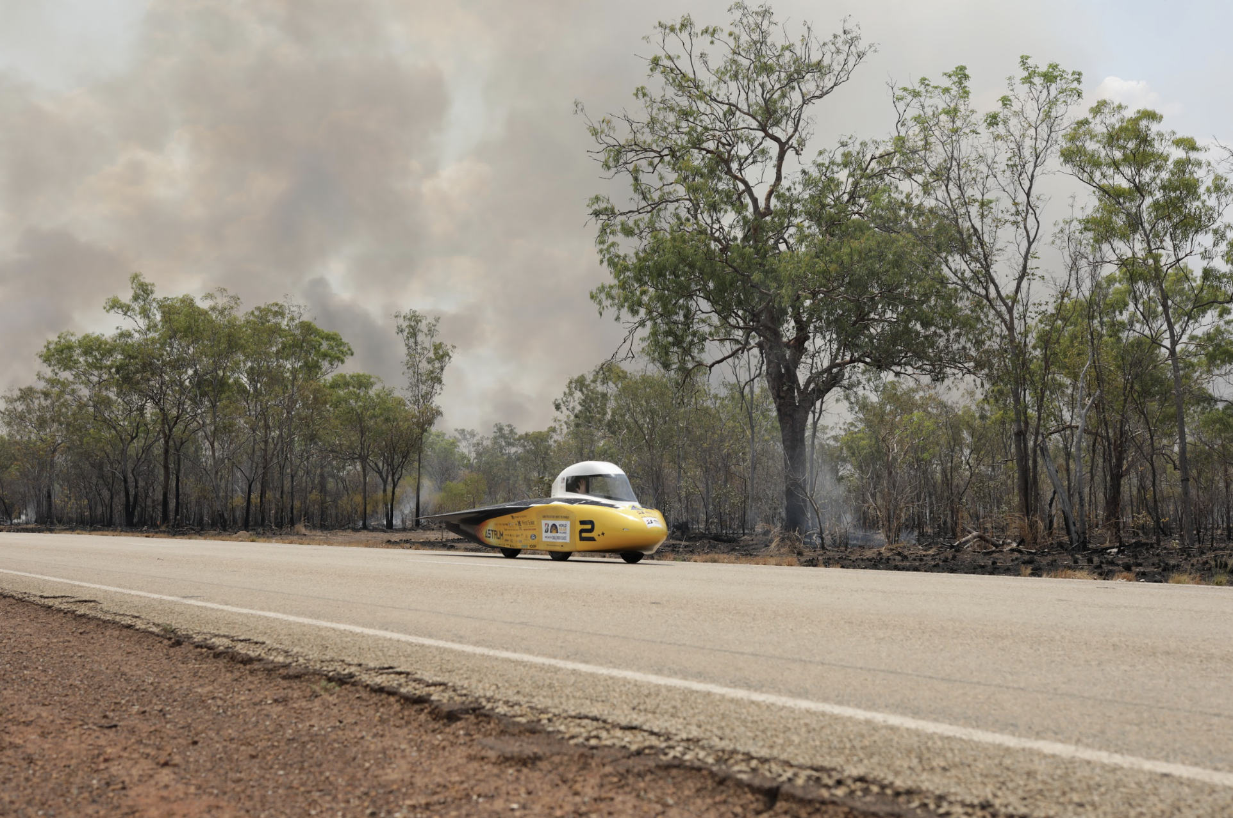

Slide 16
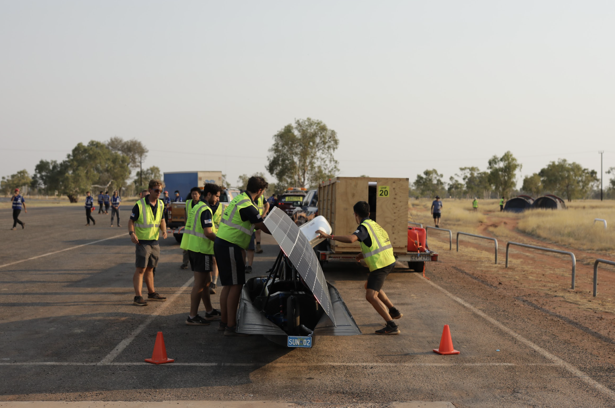

Slide 17
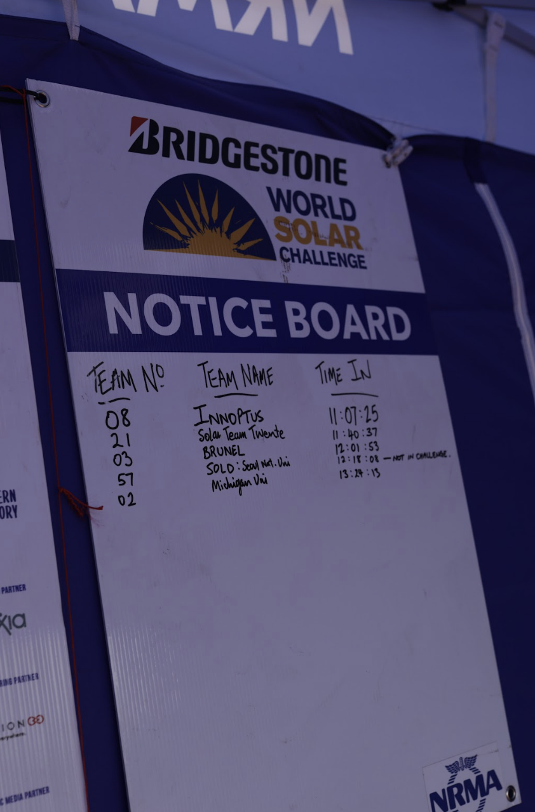
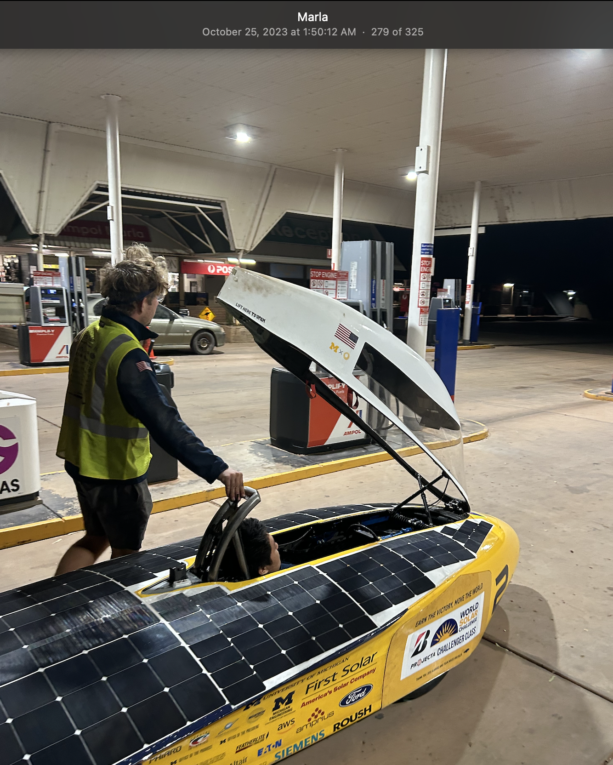

Slide 18
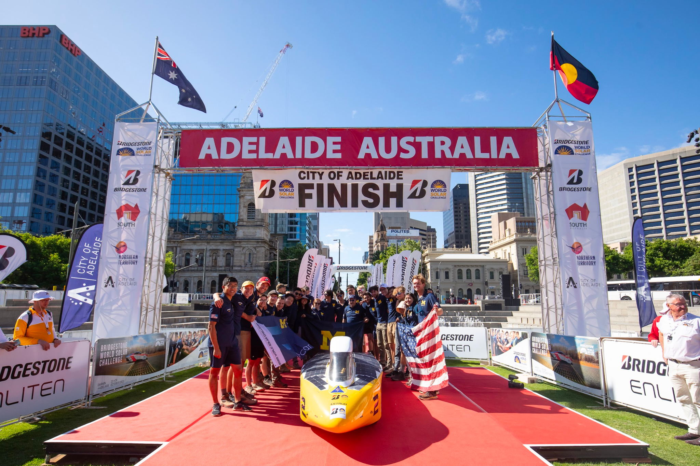

Slide 19
It’s not always glorious

Slide 20
It’s not always easy

Slide 21
It’s not always fun

Slide 22
It’s so worth it

Slide 23
Contact Information
Will Jones
Phone: 517-347-1263
Email: wbjones@umich.edu
I would love to hear from any teams!

